Slide 1
Advanced Mathematics(I)
Ping Zhu (朱 萍)
Professor & Ph.D Supervisor (教授 博士生导师)
School of Science, BUPT (北邮理学院)
E-mail：pzhubupt@gmail.com

Slide 2
Overview of this class
Bilingual
Basic concepts & useful tools of mathematics
1. Constant variable or elementary mathematics
2. Variable or advanced mathematics
3. Modern mathematics

Slide 3
Overview of this class
Theoretical Basis of Calculus
Derivate and Differential
Mean Value Theorem & Applications of Derivatives
Indefinite Integrals
Definite Integrals
Differential Equations
This semester

Slide 4
Notes for this class
Please take notes that you need
Do not speak in class
Do homework by yourself
Hand up your homework on Monday of every week with homework papers (not notebooks) from the 2nd week on
4
Notes:
4
Dr. Xia Shi
Advanced Math I

Slide 5
Grade
Homework (10%)
Mid-term examination (20%)
Final examination (70%)
5
Notes:
5
Dr. Xia Shi
Advanced Math I

Slide 6
References
1. Zhien Ma, Miansen Wang, Fred Brauer, Fundamentals of Advanced Mathematics；
2. 高等数学, 同济大学数学系编, 第七版；
3.高等数学附册---学习辅导与习题选解,同济大学数学系编；
6

Slide 7
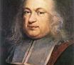
Chapter 1
Fundamental Knowledge of Calculus

Slide 8
Overview
In this chapter, we will introduce three basic concepts of calculus
Function
Limit
Continuity

Slide 9
Overview
We will often use the following logical symbols:
expresses “there exists”
expresses “there exists one and only one”
expresses “for any given”
expresses “P is equivalent to Q”

Slide 10
Section 1.1
Mappings and Functions
R
D

Slide 11
Sets [集合] and Functions [函数]
In this section, we will introduce the concepts of set and function, which are the very beginning of Advanced Mathematics.

Slide 12
The Concepts of Sets
Definition A set [集合] is a collection of all objects which are sharing some properties.
Each of the objects belonging to a set is
called an element [元素] of the set.
Remark (Notations)
Sets are always denoted as capital letters, such as A, B, … . The elements of a set usually are denoted as small letters, such as a, b, … .
The relation means that is an element of set A, read as “ belongs to ”.
The relation or means that does not belong to .

Slide 13
Finite Set and Infinite Set
Definition A set consisting of finite number of elements is called a finite set [有限集].
Definition A set consisting of infinite number of elements is called an infinite set [无限集].
Definition A set containing no element is called an empty set [空集], denoted by
Definition A set consisting of all elements under consideration in a given discussion is called universal set [全集], denoted by X .

Slide 14
Finite Set and Infinite Set
Remark (Representation of Set )
There are two ways to representing the set:
Citation: list all element of the set.
For example .
Property: point out the determining property of a set.
For example .

Slide 15
Finite Set and Infinite Set
Example: the natural number set[自然数集] is denoted by N.
Example: the positive integer set [正整数集] is denoted by N₊.
Example: the integer set [整数集] is denoted by Z.
Example: the rational number [有理数集] is denoted by Q.
Example: the real number [实数集] is denoted by R.

Slide 16
Comparing Sets
Definition Let A and B are two sets. If each element of A is element of B, then A is called a subset [子集] of B, denoted by
or ,
read as “ is contained by ” or
“ contains ”.
X
B
A

Slide 17
Comparing Sets
Definition If and , then A and B are called equal [相等], denoted by .
Example Set
Definition If and , then A is called a proper subset [真子集] of B, denoted by or .

Slide 18
Operations on Sets
Basic operations on sets
Let and are two sets.
Definition The union[并] of A and B is a set, which contains all elements of A and B, is denoted by , this means that
A
B

Slide 19
Operations on Sets
Definition The intersection [交] of two set A and B is a set, whose elements are those belong to both A and B, is denoted by , this means that
A
B
Remark If , then and are said to be disjoint.

Slide 20
Operations on Sets
Definition The difference [差] of two set A and B is a set whose elements are those belongs to both A but not to B. Denoted by , this means that
A
B

Slide 21
Operations on Sets
Definition If , then the difference is called the complement [补] of B with respect to A, denoted by .
A
B
Remark If X is the universal set, is called the complement of , denoted by or

Slide 22
Rules of Operations on Sets
Rule 1 Let , , be any three sets, then
(1) Commutative law
(2) Associative law
(3) Distributive law

Slide 23
Rules of operations on sets
(4) Idempotent law
(5) Absorption law
If then
Rule 2 (Dualization law) If A and B are two sets of the universal set X, then

Slide 24
Cartesian Product of Sets
Definition The Cartesian Product [笛卡尔积] (product, or direct product , or cross product) of two sets A and B is a set with the element as (x, y) , where x and y are elements of A and B respectively.
The product of two sets is denoted as means that
Example Let , then

Slide 25
Properties of Real Number Set
Real Number Set
Property 1 (Closure) Under rational operations, the number obtained by performing some rational operations on any two real number is also a real number.
Example Let , then
Property 2 (Order) For any two real number , one and only one of the following relations holds:

Slide 26
Properties of Real Number Set
Property 3 (Density) There must exists another real number between any two real number.
Property 4 (Completeness) If we put all the real number on the coordinate axis, then they will fill the axis.
x
Example The rational number can not fill the axis but real number can.

Slide 27
Mappings and Functions
Definition (Mapping [映射])
Let A and B be two non-empty sets.
If for every , there exist a unique corresponding to x
according to some determined rule f,
then f is called a mapping
of A into B denoted by
Here, y is called the image [像] of x under the mapping f and x is the inverse image[原像] of y. Set A is called domain of definition [定义域] of mapping f, denoted by D( f ).
The set consisting of the image y of all element is called the
range [值域] of f , denoted by R( f ) or f (A) .

Slide 28
Mappings and Functions
Example Let
and
then f is a mapping of A into B.
Example Let
and
then p is a mapping of
into

Slide 29
Mappings and Functions
Remark A mapping is also called an operator [算子] .
If , then the mapping is also called a function [函数].
If , then f is called a transformation [变换] on the set A.
If a mapping f maps every element of A into itself, then f
is called the identity mapping [恒等映射] or unit mapping [单位映射], denoted by
, that is

Slide 30
Mappings and Functions
Definition (Function [函数])
Let A and B be two non-empty
subsets of the real number set R. Then a mapping
is called a function of a single variable, denoted by
where x is called independent variable [自变量] and y is called dependent variable [因变量]. f (x₀) is called function value [函数值] at x = x₀ .
A is domain of definition [定义域] of f , denoted by D( f ) and
is called range [值域] of f , denoted
by R( f ).

Slide 31
Mappings and Functions
D = domain set
R= range set
A function from set D to set R is a rule that assigns a single
element of R to each element in D .
f (x)
single: each input in the function’s domain has only one output in the range.
x
f
Input
(Domain)
Output
(Range)

Slide 32
Notes on Functions
Domain of definition
Like the mapping, domain of definition of function is one of the essential factors in the concepts of function. To find the domain of definition of a function is to find where the rule f can be hold.
If the domain of definition is an interval [a, b] , then it is often called the interval of definition [定义区间].

Slide 33
Notes on Functions
It is well known that the interval [a, b] means the set of all real number between a and b, including a and b. That is
While (a, b) means the set of all real number between a and b, not including a and b.

Slide 34
Notes on Function
Remark
A function depends only on the corresponding rule and the domain of definitions.
Function is independent of the symbols of its variable.

Slide 35
Equal Functions
If functions f and g have the same domain of definition, and
for any x D( f ) = D( g ) , we have f (x) = g (x), then f and g
are said to be equal [相等的].
Example Judge whether the following pair of functions are equal:
Solution (1) Yes
(2) No.

Slide 36
Examples
Example Let
find the domain of definition
of function
Solution
So
Finish.

Slide 37
Examples
Example Let function
and suppose
for every
Find the representation of f (x) .
Solution
Set y =1, we have
Taking x =1, we obtain
or
So,
or
Thus,
or
Finish.

Slide 38
Express a Function
Correspondence Rule
Tabulation
Tabulate all the values of independent variable x and dependent variable y .
Graph
Draw a graph of x and y to show the relation.
Analytic representation
Use trigonometric functions, inverse trigonometric functions, exponential functions, logarithm functions and power functions to express the relation.

Slide 39
Basic functions
Constant functions
y = Const ;
Trigonometric functions
y = sin x, y = cos x, y = tan x, y = cot x, …
Inverse trigonometric functions
y = arcsin x, y = arccos x, y = arctan x, y = arccot x ;
Exponential functions
y = a^{x} , (a > 0, a ≠ 1);
Logarithm functions
y = log_{a}x , (a > 0, a ≠ 1);
Power functions
y = xª .

Slide 40
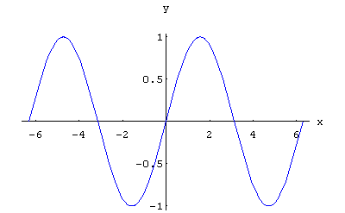
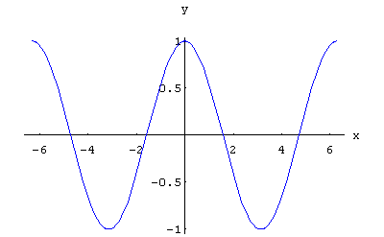
Basic functions
Trigonometric function

Slide 41
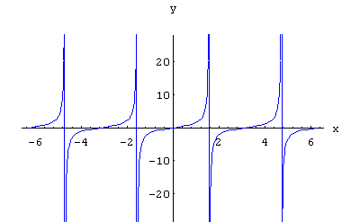
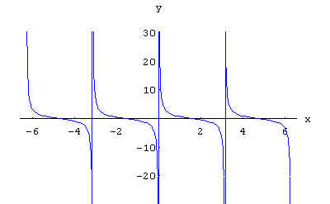
Basic functions
Trigonometric function

Slide 42
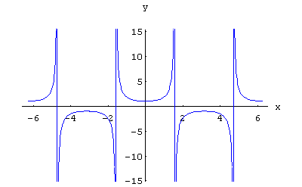
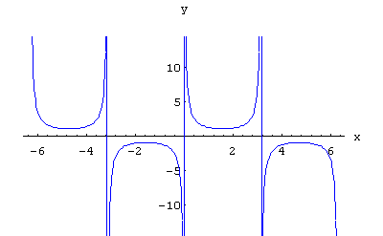
Basic functions
Trigonometric function

Slide 43
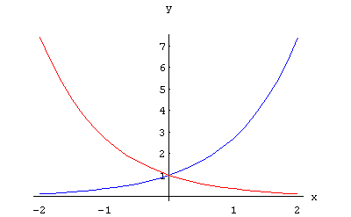
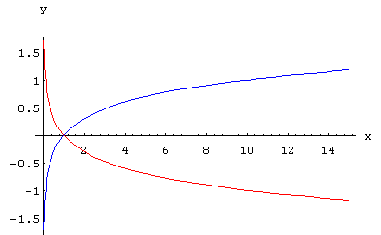
Basic functions
Exponential function
Logarithm function

Slide 44
Basic functions
Power function

Slide 45
Some functions and their graphs
Example Some basic functions and their graph
1) Constant function:
2) Piecewise defined function:

Slide 46
Some functions and their graphs
3) The greatest integer function or floor function:
this function gives the largest integer number smaller than or equal to the given real number, denoted by .
y
4 3 2 1
o
x
-4 -3 -2 -1
1 2 3 4 5
-1
-2
-3
-4

Slide 47
Some functions and their graphs
4) The sign function:

Slide 48
Some functions and their graphs
5) Dirichlet function:
6) Integer variable function:
A function is defined on the set of positive integer and denoted by
.
If we write
, then the integer variable function can be denoted as a sequence:
,
.

Slide 49
Some functions and their graphs
7) Maximum function:
.
y
x
o

Slide 50
Some functions and their graphs
8) Minimum function:
.
y
x
o

Slide 51
Primary Properties of Functions
Boundedness [有界性]
Monotonicity [单调性]
Parity [奇偶性]
Periodicity [周期性]

Slide 52
Primary Properties of Functions
Bounded
Let
and
is the domain of definition of function f .
Let
. If for any
, so that (s. t.)
,
then we call function f
is bounded [有界的] on A.
Otherwise, if for any
always
, s. t.
then we call function f
is unbounded [无界的] on A .

Slide 53
Primary Properties of Functions
y
y
M
M
y=f(x)
x
x
o
o
A
A
-M
-M
Bounded
Unbounded

Slide 54
Primary Properties of Functions
Monotone
Let
and
is the domain of definition of function f .
Let
If and , have
(or
),
we call function f is monotone increasing [单调增加的] (or monotone decreasing [单调减少的]) on A.
If
(or
),
we call function f is strictly monotone increasing [严格单调增的] (or strictly monotone decreasing [严格单调减的] ) on A.

Slide 55
Primary Properties of Functions
y
y
o
o
x
x
Strictly monotone increasing
Strictly monotone decreasing

Slide 56
Primary Properties of Functions
Even and Odd
Let
and
is the domain of definition of function f .
If
, we have
,
then, we call function f
is an even function [偶函数].
If
, we have
,
then, we call function f
is an odd function [奇函数].

Slide 57
Primary Properties of Functions
y
y
-x
o
x
x
o
x
-x
x
Even function
y
Odd function
y = x+1
1
Neither
1
x

Slide 58
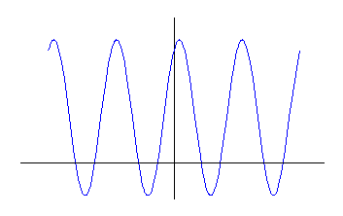
Primary Properties of Functions
Periodicity
Let
and
is the domain of definition
of function f
.
If
, so that
, we have
then, we call function f is a periodic function [周期函数].

Slide 59
Primary Properties of Functions
Example Suppose
prove that f is an even function and g is an odd function.
Proof
then
f is an even function.
then
g is an odd function.
Finish.

Slide 60
Inverse functions [反函数]
Definition (One to One Mapping [一一映射]) Suppose that f : A→B is a mapping.
corresponds to x , and
If
corresponds to y as well and satisfies
then f is called a one to one mapping from A to B,
and the sets A and B are said to be in one to one correspondence.
A
B

Slide 61
Inverse functions
Definition (Inverse Mapping[逆映射])

Slide 62
Inverse functions
Definition (Inverse Function [反函数])

Slide 63
Inverse functions
Remark
Observe that x = f ⁻¹(y) is what we obtain by solving
the equation y = f (x) for x in terms y .
It must not be confused
with the reciprocal function
For example, if
then
Interchanging x and y, we have

Slide 64
Inverse functions
In general case, the equation y = f (x) may have no solutions at all y ,
or else may have many solutions, as shown in the following diagram of a function.
y
y₂
O
x
y₁

Slide 65
Inverse functions

Slide 66
Inverse functions

Slide 67
Inverse functions
Example Find the inverse function of the piecewise function
Solution
Since f (x) is a strictly monotone increasing function on
we have
exists.
1) while
we have
2) while
we have
3) while
we have

Slide 68
Inverse functions
Example Find the inverse function of the piecewise function
Solution (continued)
So,
Therefore, the inverse function of f is
Finish.

Slide 69
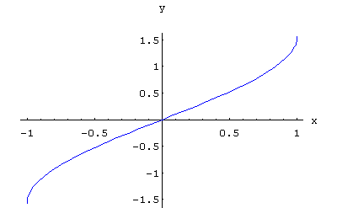
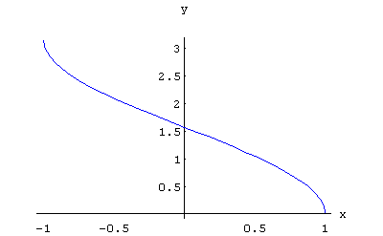
Inverse functions
Inverse trigonometric function

Slide 70
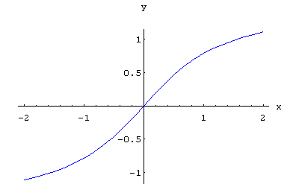
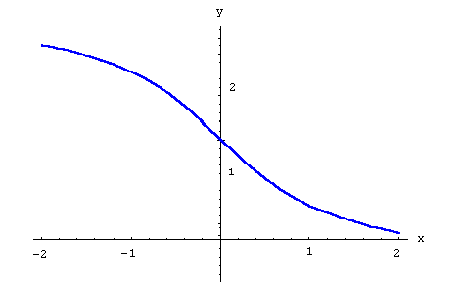
Inverse functions
Inverse trigonometric function

Slide 71
Composition Functions [复合函数]
Definition (Composite Mapping [复合映射])
Let
,
. Then for each
, there has
an unique
which corresponding to x. Again, there has
an unique
,
which corresponding to y .
Thus, for each
, there exists an unique
can be
determined by the mapping g and f. Hence, a new mapping from
A to C is determined. This new mapping is called a composite
mapping of g and f , denoted by
.

Slide 72
Composition Functions
Also the composite mapping can be written as:
That is
g
f
A
B
C
f g

Slide 73
Composition Functions
.
Definition (Composite Function [复合函数])
Let the domains of definition of the function f and g be D( f )=B
and D( g )=A respectively. If the range of g,
, then for any
, a value u can be determined by the function g denoted by
u=g( x ) , and since
, a value y can be determined by the
function f, denoted y=f ( u ). Hence for any
a value y can be
determined by function g and f. This new function
is called
composite function of function g and f.
Also the composition function can be wrote as

Slide 74
Composition Functions
x
g( x )
f [ g( x ) ]
g
f
Two functions can be composed when the range of the first lies in the domain of second.

Slide 75
Composition Functions
The domain of definition of this composite function is the set

Slide 76
Composition Functions
Example
Not any two functions have compositions.
Let
,
there does not have composition. Since D (y) = [-1,1], and
we have,
Finish.

Slide 77
Composition Functions
Remark Whether f and g can be composed into f g depends only on the relation R( g ) and D( f ), and does not depend on the symbols for the variables of these functions.

Slide 78
Composition Functions
Remark Composition of functions can be extended to any finite number of functions, such as
Since
, and
we can form the composite function
.

Slide 79
Composition Functions
Example
If
, show
Solution
By mathematical induction, we can prove that
.
Finish.

Slide 80
Composition Functions
Example Let
Please show the expression of composited function
Solution
Notice that
1) If
we have
while
while
2) If
we have
while
while

Slide 81
Composition Functions
Example Let
Please show the expression of composited function
Solution (continued)
Therefore,

Slide 82
Composition Functions
Example Let
Please show the expression of composited function
Solution (continued)
So, we have
Finish.

Slide 83
Elementary Functions and Hyperbolic Functions [双曲函数]
Definition (Elementary Functions [初等函数]):
A function formed by the six kinds of basic functions by a finite number of rational operations and compositions of functions which can be expressed by a single analytic expression is called elementary function.
Example

Slide 84
Hyperbolic Functions
Hyperbolic sine

Slide 85
Hyperbolic Functions
Hyperbolic cosine

Slide 86
Hyperbolic Functions
Hyperbolic tangent

Slide 87
Hyperbolic Functions
Hyperbolic cotangent

Slide 88
Hyperbolic Functions
There are some identities for hyperbolic functions which are similar to those for trigonometric functions.

Slide 89
Inverse Hyperbolic Functions
Inverse-hyperbolic sine

Slide 90
Inverse Hyperbolic Functions
Inverse-hyperbolic cosine

Slide 91
Inverse Hyperbolic Functions
Inverse-hyperbolic tangent

Slide 92
Review
The concepts of sets
Definition, operations, properties.
The concepts of mappings and functions
Definition, inverse mapping and function, domain of definition and range of mapping and function, composite of mappings and functions, basic functions, elementary functions, primary properties of functions.

